Slide 1
Tutorial 2
T03/08
Goh Rui Zhi
gohruizhi@u.nus.edu

Slide 2
Announcements
Assignment 1 is out! Due 20 Sept 2021, 2359 HRS
2 x Consultations happening in Week 5
- 7th Sept (Tue) 2-4pm
- 8th Sept (Wed) 2-4pm
Alternatively, email the assignment tutors directly, ask on forums or ask on Teams.
Please try the questions before attending those sessions.

Slide 3
Question 1
Bob really likes the One-Time Pad (OTP), an encryption scheme that does achieve perfect security. Bob thinks that he should be able to use the OTP by itself for a secure message communication, and not just for preserving confidentiality. Suppose Bob’s OTP keys are random and always fresh as required. His plaintexts, however, always start with “From: Bob” string, and this is known by Mallory. Mallory is a man-in-the-middle, who can intercept Bob’s ciphertexts, modify them, and then relay the modified ciphertexts to the respective receivers. Suppose now Mallory wants to modify all Bob’s OTP ciphertexts so that, when decrypted by their respective receivers using correct keys, the recovered plaintexts start with “From: Bot” instead.
What should Mallory turn each OTP ciphertext from Bob into? Explain briefly why your attack works.
(Note: Suppose the two relevant characters are encoded using their following ASCII-based binary strings: ‘b’ → 0110 0010, ‘t’ → 0111 0100.)

Slide 4
Question 1
Consider flipping a single bit in ciphertext C to get C*. What happens to the final decrypted message, M*?
=> Corresponding bit will be flipped in M* as compared to M!
Answer:
Let the 9th Byte of a binary string S, be denoted by S[8] (zero based)
Flips need to make ‘b’ => ‘t’ = Difference between ‘b’ and ‘t’ = ‘b’ ⊕ ‘t’ = 01100010 ⊕ 01110100 = 00010110

Slide 5
Question 1
Simply perform the following to obtain C*:
C*[i] = C[i], for i between 0 and n, except when i = 8
C*[8] = C[8] ⊕ (‘b’ xor ‘t’) = C[8] ⊕ 00010110
Prove that M*[8] is ‘t’:
M*[8] = C*[8] ⊕ K[8]
= [C[8] ⊕ (‘b’ ⊕ ‘t’)] ⊕ (C[8] ⊕ ‘b’) Since C[8] ⊕ K[8] = ‘b’
= ‘t’ // Proved

Slide 6
Attackable otp?
Doesn’t OTP achieve Perfect Secrecy? Why can it still be attacked?
Perfect Secrecy: Ciphertext reveals no information about the contents of the plaintext
One time pad (or other encryption schemes) preserves Confidentiality NOT Integrity!
Note: There are times where encryption algorithms are used to preserve Data Integrity e.g. encrypting using a private key to “sign” the message.

Slide 7
Question 2
Bob is designing a block cipher that performs complex operations similar to those in AES.
He believes that he can combine the strengths of both block cipher (e.g. high confusion and diffusion) with that of stream cipher (e.g. lower latency) if he makes the block size rather small. Hence, he sets the size of the input and output blocks of his cipher to 16 bits only.
Alice, however, warns Bob that his block cipher can be attacked due to its small block size.

Slide 8
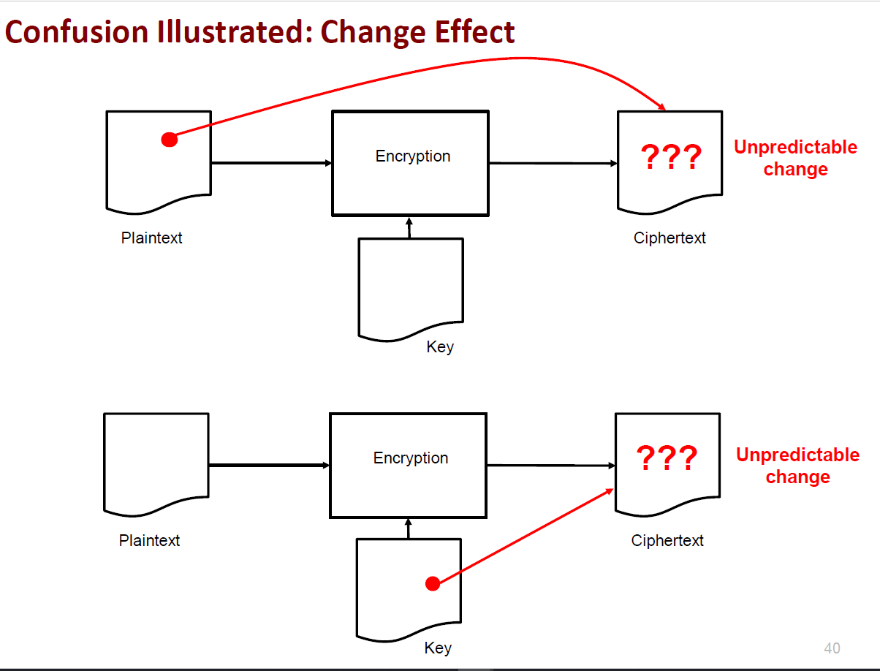
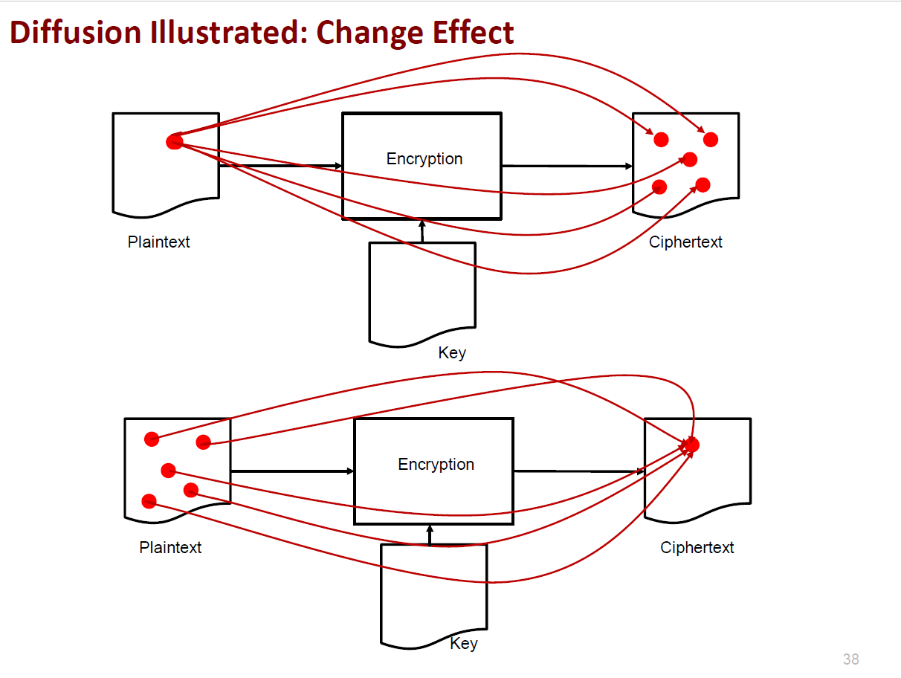
Confusion vs diffusion

Slide 9
Question 2a
Consider a known-plaintext attack scenario, where an attacker can learn a number of
plaintext and ciphertext pairs encrypted using the same key. Suppose the attacker wants
to implement a codebook attack on Bob's Cipher, which is a block cipher with a small
block size, by compiling a lookup table of all plaintext-ciphertext pairs observed under
the same key. How much storage will the attacker need to comprehensively store all the
input and output blocks in his table? Express your answer in MB (megabyte) or GB
(gigabyte).
Note: 1MB = 2²⁰, 1GB = 2³⁰.

Slide 10
Question 2A
Generate the look up table
Each input output pair takes 32 bits = 4 bytes (16 bits plaintext + 16 bits ciphertext)
Table size = Size of Entry × Number of Possibilities = 4 bytes × 2¹⁶ = 2¹⁸ bytes = 2⁻² MB = 0.25 MB

Slide 11
Question 2b
Given Alice's warning and possible codebook attack, Bob agrees to increase the size
of the input and output blocks of his cipher to 48 bits. Using the same codebook
attack, how much storage will the attacker now need to store all the input and output
blocks in his lookup table? Express your answer in MB (megabyte), GB (gigabyte), TB
(terabyte), or PB (petabyte).
Note: 1T = 2⁴⁰, 1P = 2⁵⁰.

Slide 12
Question 2b
Plaintext block size = Ciphertext block size = 48 bits
Each pair now takes 96 bits = 12bytes
Table size = entry size × number of possibilities = 12 bytes × 2⁴⁸ = 3 . 2⁵⁰ bytes = 3 PB

Slide 13
Question 3
Cipher Block Chaining (CBC) mode-of-operation is commonly used to encrypt a plain-
text longer than a cipher's block. In CBC, each plaintext block is XOR-ed with the previous
ciphertext block before being encrypted. An IV is used in encrypting the first plaintext block.
Mathematically, the encryption can thus be expressed as follows:
Given a n-block plaintext message x₁, x₂, x₃, ... , x_{n}, a secret key K, and an IV,
CBC outputs (n+1)-block ciphertext message y₀, y₁, y₂, ... , y_{n}, where:
1. y₀ = IV ;
2. y_{k} = Enc_{K}(x_{k} ⊕ y_{k-1}), for k = 1, 2, 3, ... , n.

Slide 14
Question 3
Given the defnition above, answer the following questions:
(I) Your lecture notes show a diagram depicting how a CBC-based encryption is done.
Draw a diagram of the corresponding CBC-based decryption.

Slide 15
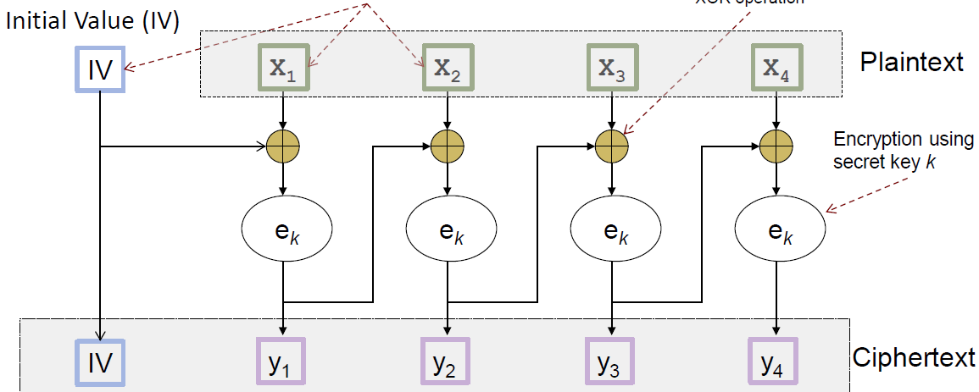
Recall Encryption
y₁ = Enc_{K}(x₁ ⊕ y₀)

Slide 16
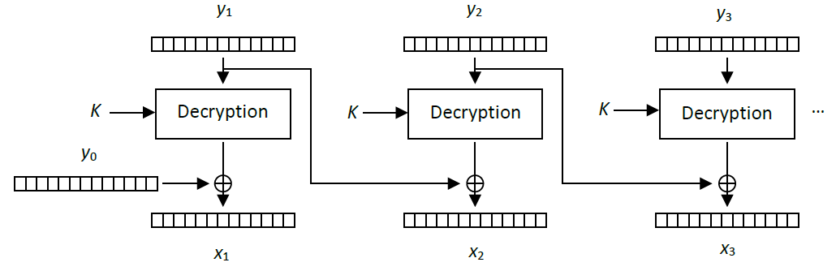
Decryption
y₁ = Enc_{K}(x₁ ⊕ y₀)

Slide 17
Question 3
(ii) How is decryption affected if the first ciphertext block y₀ is removed from the ciphertext?

Slide 18
Question 3
(iii) Can the encryption processes of different blocks belonging to a plaintext run in parallel? How about the decryption of a ciphertext's different block?

Slide 19
Encryption: Not possible
Dependent on Y_{n-1} to XOR

Slide 20
Decryption: Possible
Y_{n-1} is readily available in ciphertext blocks

Slide 21
Question 4
Bob knows that DES has a rather short key size/length of 56 bits. He, however, still wants to employ DES due to its widespread availability. Bob thinks that he has found a good way of addressing the limited key length of DES by randomly selecting three different keys K₁, K₂ and K₃. Bob then performs his DES encryption as follows:
C = E_{K1⊕K2⊕K3} (P):
Decryption process is then performed using K₁ ⊕ K₂ ⊕ K₃ as its key. Bob argues that his method significantly increases the key space size.
(a) Is Bob's argument correct? Argue concisely by comparing the key space size of using one and three keys above.

Slide 22
Question 4
Key Space: Only affected by length of key!
K₁ ⊕ K₂ ⊕ K₃ remains as 56 bits
Key space size remains as 2⁵⁶

Slide 23
Question 4 b
Bob now uses only two secret keys K₁ and K₂. However, he modifies his encryption to
implement 2DES as follows:
C = E_{K2} (E_{K1} (P))
Bob now believes that his double-encryption method indeed doubles the key space size to
2^{2 × 56} = 2¹¹², and brute-forcing correspondingly requires 2¹¹² cryptographic operations.
How can you tell Bob that, under the known-plaintext attack, there is a way to find
his two keys by performing 2 × 2⁵⁶ = 2⁵⁶ ⁺ ¹ = 2⁵⁷ cryptographic operations only?

Slide 24
Meet in the middle attack
Again, makes use of the trade-off between Space and Time.
In a known plaintext scenario:
Step 1: Encrypt Plaintext P with all possible keys (2⁵⁶). Store all candidate intermediary in a table U.
Step 2: At the same time, Decrypt Ciphertext S with all possible keys (2⁵⁶). Store all candidate intermediary in a table V.
Step 3: Find the common intermediary. The associated keys will be your keys.
Total operations needed: 2 x 2⁵⁶
**Only possible because we know the plaintext (Known plaintext attack)

Slide 25
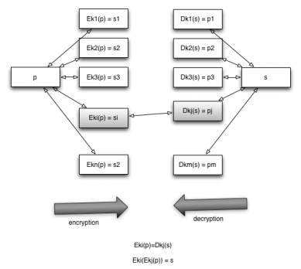
Table U
Table V
Want to find:
E_{Ki} (p) = D_{Kj} (s)
https://www.infoarena.ro/blog/meet-in-the-middle

Slide 26
Further discussion: 3des
E_{k1} (D_{k2} (E_{k1} (x)))
Is 3DES (using 3 different 56bit keys) effective under Meet in the middle attacks?
What is the effective key space of 3DES under meet in the middle attacks?
=> 2^112 + 2^56 (Lower Bound) // NOT 2^168 !
How about 4DES (if there is one)?
=> 2 x 2^112 (Lower Bound)

Slide 27
Question 5
Your lecture notes have mentioned two 3DES encryption options, namely:
1. E_{k1} (E_{k2} (E_{k1} (x))); and
2. E_{k1} (D_{k2} (E_{k1} (x))).
The latter is quite popular due to its extra benefit. It can provide a backward compatibility with the (single) DES.
Explain succinctly how one can use 3DES to be compatible with, or simulate, DES.

Slide 28
Question 5
How to make E_{k1}(D_{k2} (E_{k1}(x))) = E_{k1}(x)?
We simply let k2 = k1
E_{k1}(D_{k1} (E_{k1}(x))) = E_{k1}(x)
Back to one key system

Slide 29

Thank you
Any questions?

